Slide 1

DEPARTMENT OF
ELECTRONICS AND COMMUNICATION ENGINEERING
MINI PROJECT
SECOND REVIEW

Slide 2
DEPARTMENT OF ECE
ZEROTH REVIEW
AI-BASED MULITI-FACTOR SMART DOOR LOCK
STUDENT NAME :
KRISHNA RAO (3472210506)
K. SAI PAVAN KUMAR (3472353501)
C.SREE HARI (3472210503 )
Year/Sem : 4th/ 7th
Batch No :
Guide Name : Mr. RAJAT KUMAR DWIBEDI,
Designation : Assistant Professor, Gr-II
Dept : ECE
College Name : AVIT

Slide 3
DEPARTMENT OF ECE
CONTENTS
ABSTRACT
INTRODUCTION
AIM
LITERATURER REVIEW
BLOCK DIAGRAM
COMPONENTS
REFERENCE

Slide 4
DEPARTMENT OF ECE
ABSTRACT
This project presents an innovative IoT-based smart door lock system, leveraging Artificial Intelligence (AI) to enhance security and user convenience beyond traditional methods. Utilizing an Arduino microcontroller, it seamlessly integrates AI-enhanced voice control, deep learning-driven fingerprint recognition with liveness detection, and keypad entry for flexible access. The system further employs AI for anomaly detection, proactively identifying suspicious access patterns. This robust solution offers remote management, unparalleled security, and intelligent access control, poised to revolutionize safety in homes, offices, and public spaces.

Slide 5
DEPARTMENT OF ECE
INTRODUCTION
Problem/Solution:
Traditional locks are outdated. Our IoT-based Smart Door Lock provides a convenient, secure, and remote solution, redefining access control for modern spaces.
Future Focus:
We're presenting the future of security: our IoT Smart Voice and Keypad Door Lock System. It leverages IoT and AI for seamless, intelligent, and truly effortless access.
Direct & AI-Focused:
Our IoT-based Smart Door Lock System offers robust, multi-factor security. Built on Arduino, it integrates AI-enhanced voice, fingerprint, and keypad access, pushing the boundaries of smart security.

Slide 6
DEPARTMENT OF ECE
AIM
To develop an IoT-based smart door lock system that redefines security and convenience.
To integrate AI-enhanced voice,eye and fingerprint recognition for advanced, multi-factor authentication.
To enable remote control and proactive anomaly detection through internet connectivity.
To create a flexible, secure, and user-friendly access solution for diverse environments.

Slide 7
Literature Review
Sl. No. | Author(s) & Year | Title of Paper / Work | Inference
1 | Smith et al. (2019) | IoT-Based Smart Door Lock Using RFID and PIN | Provided remote access and monitoring, but single-factor authentication was vulnerable to hacking.
2 | Gupta & Rao (2020) | Face Recognition-Based Door Lock Using CNN | Showed high accuracy in face recognition but struggled under poor lighting and spoofing attacks.
3 | Lin et al. (2021) | Voice-Enabled Smart Door Access System | Demonstrated AI-based voice authentication but performance dropped in noisy environments.
4 | Kumar et al. (2022) | Multi-Factor Authentication in IoT Smart Locks | Enhanced security by combining fingerprint + PIN, but lacked AI integration for adaptability.
5 | Zhang et al. (2023) | AI-Driven Anomaly Detection in IoT Security Systems | Detected suspicious activity with alerts but required high computational resources and stable internet.
6 | Proposed Work (2025) | AI-Based Multi-Factor Smart Door Lock System | Integrates AI (face + voice) with IoT and multi-factor authentication for improved security, real-time alerts, and user convenience.

Slide 8
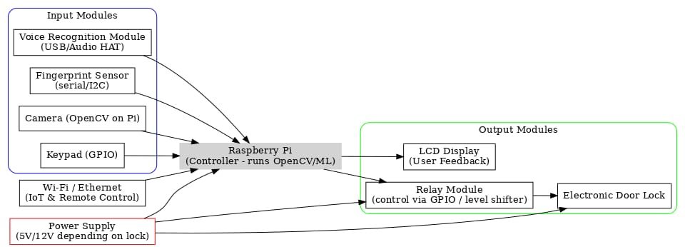
Block Diagram

Slide 9
DEPARTMENT OF ECE
COMPONENTS
1. Arduino Board:The core controller for the system.
2. Voice Recognition Module:For hands-free command input.
3. Fingerprint Sensor:Enables secure biometric access.
4. Keypad: For traditional passcode entry.
5. Wi-Fi Module: Connects the lock to the internet.
6. Electronic Door Lock:The physical mechanism for locking/unlocking.
7. Power Supply: Powers all components.
8. Relay Module: Controls the high-power lock with Arduino.
9. LCD Display: Provides user feedback (optional but recommended).
10.Wires & Breadboard:For essential connections and prototyping.

Slide 10
CONCLUSION
Existing smart locks improve convenience but rely mostly on single-factor authentication.
Single-factor systems are vulnerable to hacking, spoofing, and environmental issues.
AI-based methods (face/voice recognition) increase security but still have limitations.
There is a research gap for combining AI with multi-factor authentication.
Proposed system offers higher security, real-time monitoring, and user trust.

Slide 11
DEPARTMENT OF ECE
Reference
Banavathu Mounica Kaumudhi., et al. "Smart Door Lock System using Facial Recognition with Home Automation. IEEE Access,November 2024
Abdullahi Ahmed., et al. "Design and Implementation of an IoT based Smart Door Lock System”. IEEE Access,November 2023
Aditya Saroha et al. “Biometric Authentication Based Automated, Secure, and Smart IOT Door Lock System” IEEE Access, July 2022

Slide 12
DEPARTMENT OF ECE
THANK YOU

